Slide 1

Engineering Plan
Review Process
How to Obtain Approval for New Construction or for Changes to an Existing Public Water System or Wastewater System
Alaska Department of Environmental Conservation
Drinking Water Program & Wastewater Program
Prepared by Johnny Mendez, P.E., Tonya Bear, P.E. & Shawna Laderach, P.E.

Slide 2
DEC-DW Program Mission
The Drinking Water Program is responsible for requiring public water systems to supply safe drinking water that meets minimum federal health-based standards, established by the Environmental Protection Agency as required by the federal Safe Drinking Water Act.
Notes:
Summary of the actual verbiage

Slide 3
DEC-DW Engineering Group Mission
The Drinking Water Program engineers protect public health by overseeing the design, construction, and operation of public water systems. We strive to efficiently implement regulatory requirements with predictability, thoughtfulness, and clarity, while allowing for site specific accommodations when possible.

Slide 4
How do DW Engineers Help Achieve the Program’s Mission?
Review and approve engineering design plans for new construction and modifications to public water systems
Verify that proposed changes will not pose a risk of contamination to the drinking water supply
Provide technical assistance to water system owners & operators
Inspect water systems to verify proper operation and maintenance and check for sanitary deficiencies (Sanitary Surveys)
Conduct Status Component Inspections (water treatment plants)
Help water systems optimize their treatment processes to achieve the best possible drinking water quality (Comprehensive Performance Evaluations)

Slide 5
Types of Water Systems
Community (C) Public Water System (PWS): (formerly known as Class A PWS) serves at least 15 service connections used by year-round residents or regularly serves at least 25 year-round residents (e.g. city water utility, residential subdivision, trailer park)
Non-Transient Non-Community (NTNC) PWS: (formerly known as Class A PWS) regularly serves at least 25 of the same individuals (non-residents) over six months per year (e.g. office building, school)
Transient Non-Community (TNC) PWS: (formerly known as Class B PWS) serve a transient population of 25 or more people or the same 25 people less than 6 months but more than 60 days per year (e.g. small church, restaurant, lodge, motel, ski resort)
Private Water System (not federally regulated): serves less than 25 people or operates less than 60 days/year (e.g. small office, small lodge, B&B, triplex, hair-salon, single family residence, duplex)
Notes:
Former Class C PWS (State regulated PWSs) were removed from regulation in 2017.

Slide 6
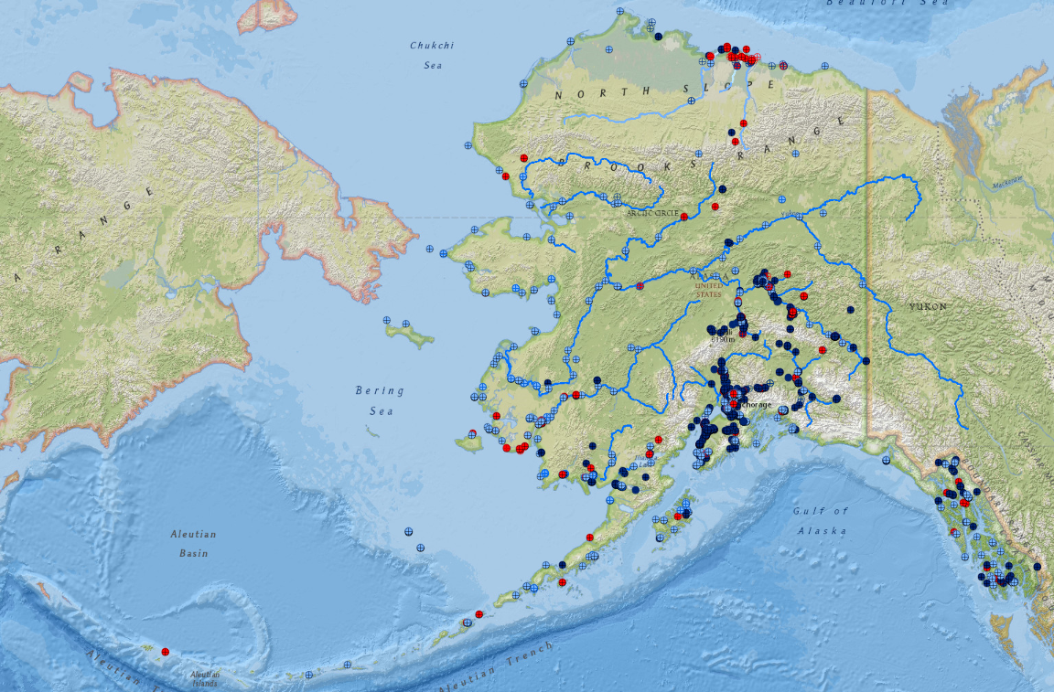
Public Water Systems in AK
Notes:
2 arms of DEC drinking water: Compliance and Engineering. 1,409 PWS in Alaska (283 in Northern Region).
Northern Region is above the yellow dashed line

Slide 7
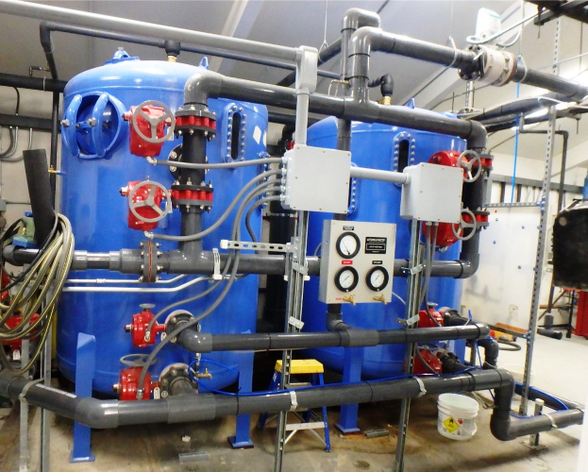
When is an Engineering Plan Review Required?
For changes or modifications of a PWS
For new construction of a PWS
Private Water Systems → Plans required only if there is a separation distance waiver to a wastewater disposal system. DEC Wastewater Program reviews the waivers (DW Program not involved).

Slide 8
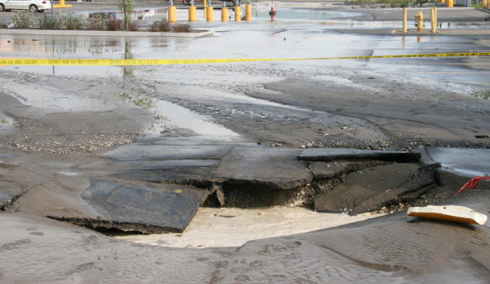
When Are Plans Not Required?
Written approval is not required for emergency repairs, routine maintenance or for a single-service line installation or modification.
  Routine maintenance includes activities that are normally required to maintain a public drinking water system in good working order but does not include any change that will affect the configuration of the system, materials, treatment, or capacity:
    Replacing a pump (in-kind)
    Replacing 40 feet or less of main
    Maintaining valves
    Replacing a hydro-pneumatic tank
    Replacing of spent filter media (in-kind)
  Emergency repair->Notify DEC ASAP
Notes:
if you are replacing an old component you should look for a ANSI/NSF 61 component for the replacement as these might not have been available when originally constructed but may be available now but it is always a good idea to contact the Drinking Water staff to make sure that what you are doing falls under routine maintenance.
If an emergency repair is conducted, please contact DEC as soon as possible with details on the changes that were made. It is possible we may ask you for a schematic, photos, and/or specs of the changed components to document the changes for our file. DEC may also request details on what caused the emergency and how it would be prevented from occurring again in the future. Note an emergency is not a scheduled event (e.g. replacing a section of water main that has been historically leaking because all of the sudden funds became available).

Slide 9
How Does the DW Engineering Plan Review Process Work?
Water system owner hires a Registered Professional Engineer.
Engineer uses DEC Drinking Water checklists to prepare a submittal for review and approval.
Engineering submittal with report, drawings, and fee payment is submitted to DEC.
DEC reviews complete submittals (~30 days).
DEC Grants Approval to Construct if all regulatory requirements met (good for 2 yrs). If separation distance waiver requested, it is approved at this stage.
Project is constructed.
Approval to operate request sent to DEC (no checklists for this-look at construction approval letter for requirements).
DEC Grants Interim (90 days) or Final Operation Approval (if all construction approval conditions are met).
Owner can start using water system or modification.
Notes:
No checklist for Operational Approval—Need to pay attention to construction approval letter.
Rarely is a system wide final approval to operate granted, some small systems may receive it if they consist only of a source and distribution but most larger water systems go through changes routinely so many times operational approval is only granted for a portion of the water system.
Phased construction with multiple interim approvals with one final after all has been completed: For example you may be adding long extensions of water mains and want portions of them to be put in operation before the entire project is complete. You can request interim approval for a portion of the project so that it can be used until the entire project has been completed.--if approval expires we may be able to issue a new construction approval

Slide 10
DEC Drinking Water Engineering Review Process
New C, NTNC, or TNC PWS
Private Water System that increases population served or dates of operation & becomes C, NTNC, or TNC PWS
Separation Distance to Source or Water main not Met?
Modifications to a
C, NTNC, or TNC PWS
Engineering Plan Review
Required
Separation Distance
Waiver Required
Submit Separation Distance Waiver Request to DEC
Submit Engineering Plans to DEC
(Use Appropriate Checklists)
Complete Submittal?
DEC Review
DEC Review
Yes
Yes
No
No adverse impact
to Public health?
Meets Regulation?
Submit Missing
Information
Yes
No
Yes
No
Construction Approval
Approve Waiver
Deny Waiver
Operation
approval
requirements
met?
Project
Constructed
Request Interim or Final Operation Approval
Operation
Approval

Slide 11
Plan Review Checklists
Guidance to help PWS engineer prepare a complete submittal for construction approval of new public water systems, system modification, or separation distance waiver requests.
Can be found online in the DEC Drinking Water website: http://dec.alaska.gov/eh/dw/engineering/plan-review/
Additional information, beyond checklist questions, may be requested by the Department as part of the plan review process.
Checklist (except for Checklist 0.0) are not required to be submitted,
  but it helps speed up the review if you point where
  in the submittal DEC can find the answers to relevant
  checklist questions
Notes:
Purpose is to assist engineers in submitting complete applications for construction approval ……going through the checklists and checking them is not adequate. The DW engineers are interested in the information referenced. It is important to actually go to the regulation to see what is required. Example is in the source checklist it asks for information on separation distances from potential sources of contamination, you need to read the regulations to find out what the separation distances are and address those in the checklists.
It also helps to tell us where that information is located in the submittal, ie plan sheet or attachment, etc

Slide 12
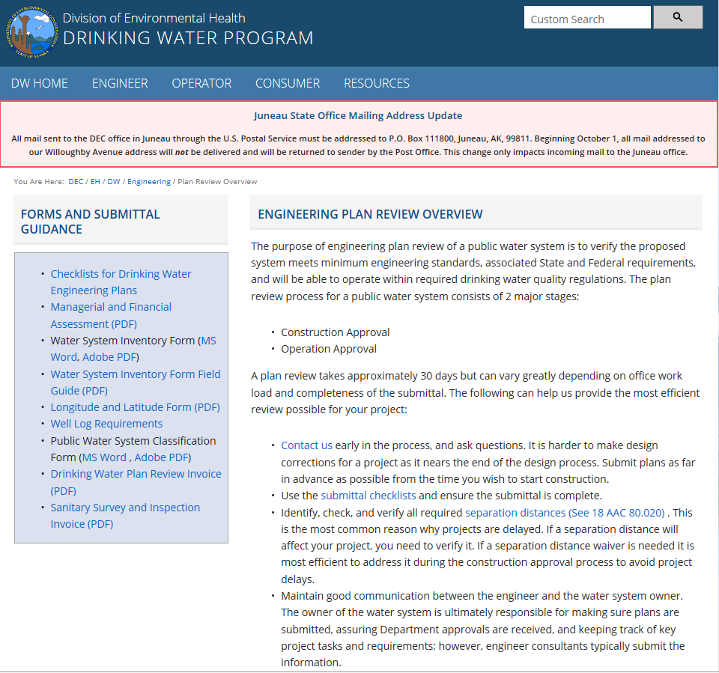
http://dec.alaska.gov/eh/dw/engineering/plan-review/
Notes:
Use online engineering checklists for demonstration at this point (if available)

Slide 13
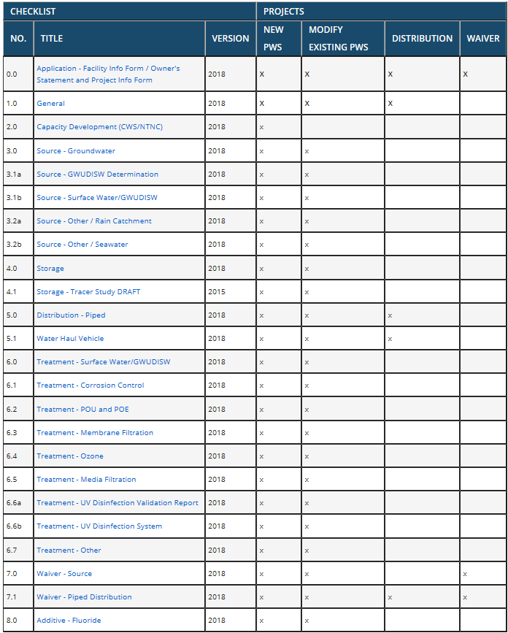
Notes:
Use the chart to see which checklists are required for your specific project.
These forms are interactive and allow you to complete them, save, and print. You can also choose the All Check list in the MS Word format that are editable and save them to your computer to integrate with your engineer’s report.

Slide 14
Timelines
The timelines for the plan approval process can vary greatly (Goal is 30-day turnaround) depending on some of these:
  Completeness of the initial submittal
  Submission of additional information
  Payment of the fee
    Plans will not be reviewed until the fee has been paid
  Complexity of the project
  Time of year
  Workload of the DW Program engineering staff
  Communication between submitting engineer and DW Program staff
Notes:
We try to do the review within 30 days. However, it is rare to be able to issue a construction approval within 30 days. Interim approvals we try to turn right around as they are usually anxious to get the water on once the project is completed.
You can do preparatory work for a project, digging trenches, getting equipment ready, supplies…Just as long as the water system work is not started.
Do not wait until you are ready to break ground to request construction approval. Give yourself plenty of time since there may be problems with the submittal, do not think that you are going to submit a plan review request and have your approval within a week, its not going to happen so plan ahead and submit ahead!

Slide 15

Wastewater Permitting and Plan Review
Alaska Department of Environmental Conservation
Division of Water
Wastewater Discharge Authorization Program

Slide 16
Division of Water
Mission Statement:
  Improve and protect water quality
How?
  Establishes standards for water cleanliness
  Regulates discharges to waters and wetlands
  Provides financial assistance for water and wastewater facility construction and waterbody assessment and remediation
  Trains, certifies, and assists water and wastewater system operators
  Monitors and reports on water quality

Slide 17
Permitting Overview
Wastewater permitting authority stems from the Clean Water Act
EPA administers nationwide permitting, but can delegate to States and Tribes
State of Alaska authority comes from AS 46.03.100
Governing State Regulations:
18 AAC 15 – Administrative Procedures
18 AAC 70 - Water Quality Standards
18 AAC 72 – Wastewater Discharge
18 AAC 83 - APDES

Slide 18


Alaska Pollutant Discharge Elimination System (APDES)
          NPDES APDES
DEC
Water
Environmental Health
Air
WDAP
SPAR
Admin
Oil & Gas
Domestic
Mining
Stormwater
Engineering Spt
Discharge Permits
Plan Review
Notes:
WDAP= WW Discharge Authorization Program

Slide 19
When is a Discharge Permit Required?
Generally any wastewater discharges to surface water (fresh or marine) require a permit (in addition to plan approval)
Typically coverage is under a General Permit
  AKG573000 – Small Domestic Lagoon to Surface Water
  AKG572000 – Small POTW and Other Small Treatment Works
  AKG250000 – Non-Contact Cooling Water
  AKG380000 – WW Discharges from Drinking Water Treatment Facilities
If no general permit is available, an individual permit may be issued or plan review in lieu of permit may be an option
Notes:
GPs need notice of intent except for GP for aquifer testing and chlorinated H20 discharge, which has some cases where notice not required
There are other GPs not mentioned here.

Slide 20
When is an Engineering Plan Review Required?
For new construction, changes or modifications of a community sewer system, sewer main, or an alternative treatment system.
Private Residences and Small Commercial Facility (<500 gpd) only requires submission of a Documentation of Construction (as long as it is a conventional system and meets separation distance requirements)

Slide 21
When Are Plans Not Required?
Written approval is not required for emergency repairs, routine maintenance or for a single-service line installation or modification.
  Routine maintenance includes activities that are normally required to maintain a community wastewater or collection system in good working order but does not include any change that will affect the configuration of the system, materials, treatment, or capacity:
    Replacing a pump (in-kind)
    Replacing of pipe (same size and in same place)
  Emergency repair->Notify DEC ASAP
Note: Lining of pipe is NOT considered routine maintenance.
Notes:
If an emergency repair is conducted, please contact DEC as soon as possible with details on the changes that were made. It is possible we may ask you for a schematic, photos, and/or specs of the changed components to document the changes for our file. DEC may also request details on what caused the emergency and how it would be prevented from occurring again in the future. Note an emergency is not a scheduled event (e.g. replacing a section of water main that has been historically leaking because all of the sudden funds became available).

Slide 22
How Does the Engineering Plan Review Process Work?
Wastewater system owner hires a Registered Professional Engineer.
Engineer uses DEC checklists to prepare a submittal for review and approval.
Engineering submittal with report, drawings, and fee payment is submitted to DEC.
DEC reviews complete submittals (~30 days).
DEC Grants Approval to Construct if all regulatory requirements met (good for 2 yrs). If separation distance waiver requested, it is approved at this stage.
Project is constructed. Construction Approval includes a 90 day Interim Approval to Operate
Approval to operate request sent to DEC (no checklists for this-look at construction approval letter for requirements).
DEC Grants Extended Interim or Final Operational Approval (if all construction approval conditions are met).
Owner can continue using wastewater system or modification.

Slide 23
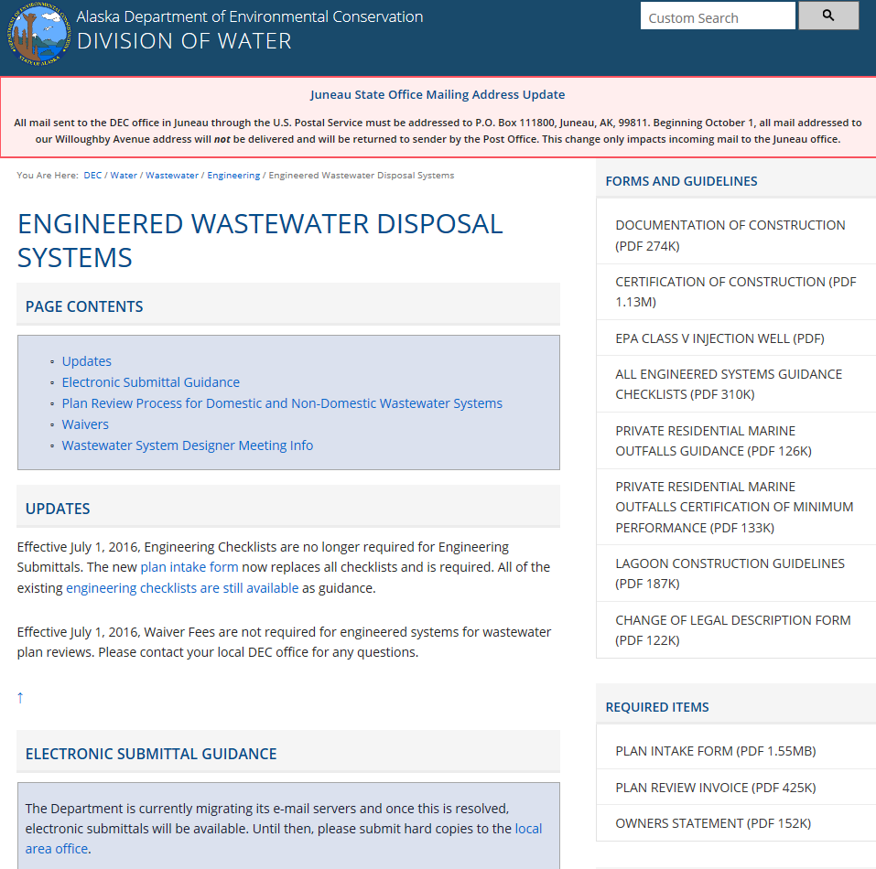
https://dec.alaska.gov/water/wastewater/engineering/engineered-systems

Slide 24
Rural Alaska Challenges
Limited capital funding and high construction costs
High O&M costs and non-cash based economies
Retaining skilled operators and knowledge transfer
Climate change affecting utilities and communities (e.g. permafrost degradation, coastal erosion->exposes infrastructure, algal blooms, change in precip. patterns)
Monitoring and reporting system performance
Vague basis of design guidance
Septage disposal (some Class III landfills can accept it)
Honey Bucket lagoons still allowed.
Notes:
Villages along coast line may be under “76 village waiver” or section 301-H waiver that allows them to discharge to an ocean outfall with only primary treatment.
Septage disposal in Class II landfill needs design of a septage trench and approval by DEC-Solid Waste program.
Honey Bucket lagoons, if designed need to be lined
Sewage Lagoons still OK, but need to be two-cell design.
Arctic Design Engineering references are old or non existent. E.g. Need update to Cold Climate Utilities Delivery Design Manual (1979).
Climate Change examples:
Permafrost degradation caused N. Slope lake (community DW source) to drain into a river
Wells in Northern AK interior community being eroded by river (at least two)
Ketchikan reservoir running dry b/c of lack of precipitation in summer
Poor design and/or QA/QC can affect longevity of projects (Even with resilient materials like HDPE pipe!)-E.g. pipe leaks due to deflection caused by poor bedding design and/or permafrost degradation pulls joints apart. Bad HDPE fused joints b/c QA/QC not followed or improper material specified for conditions.
Inadequate operator training can make even the best systems not work right. Example: water hammer broke SCH 80 PVC pipes at WTP in SE Alaska because operator shut off a valve too fast.

Slide 25
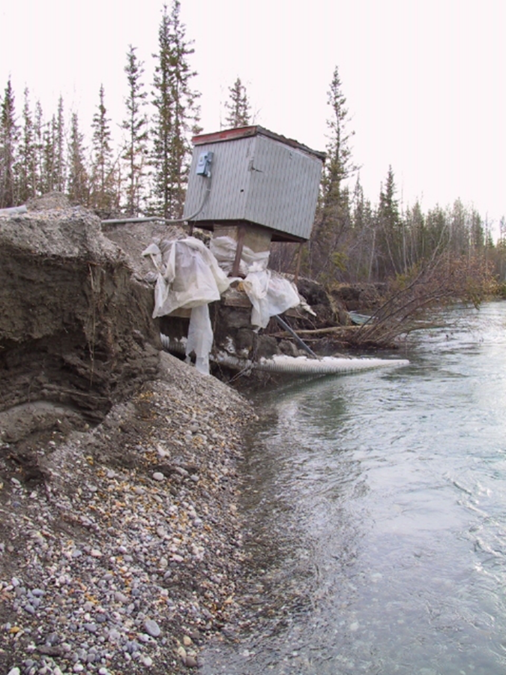
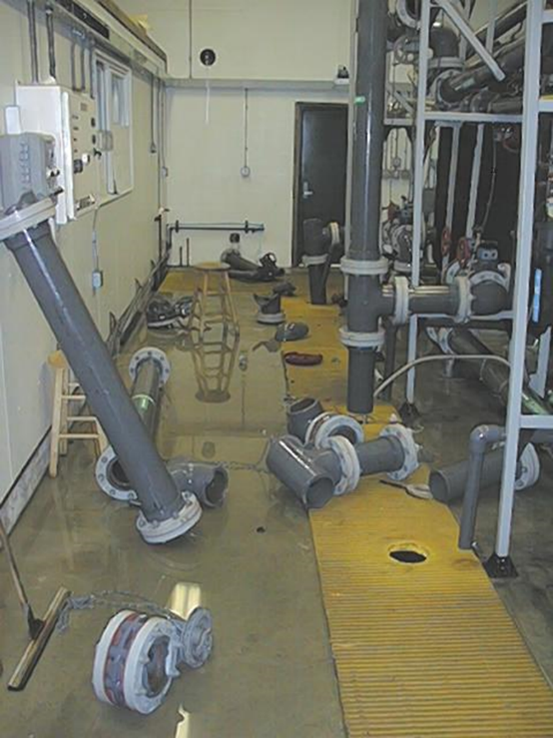
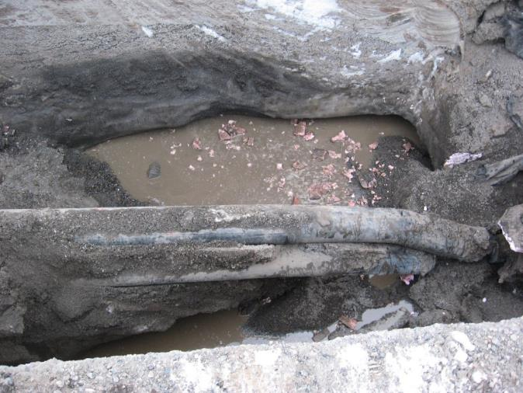
Challenges
Erosion causing well to go into river
Operator Training
Construction standards/ QA/QC

Slide 26
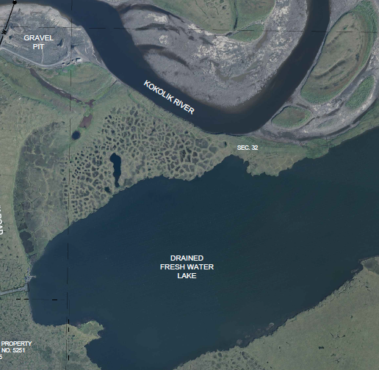
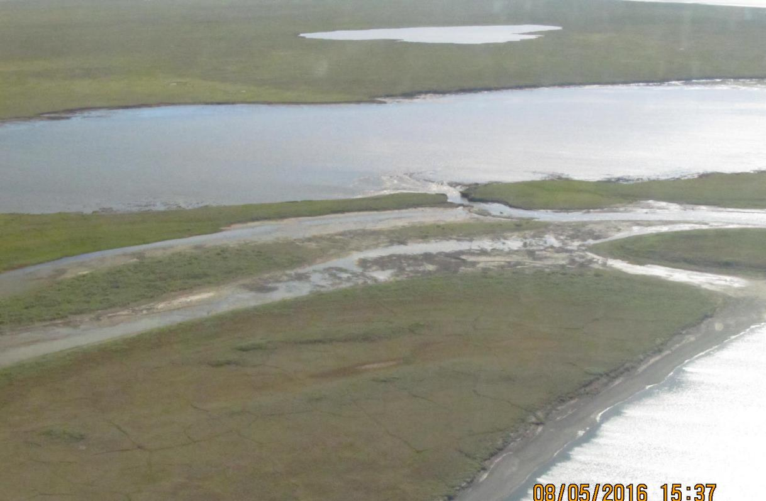
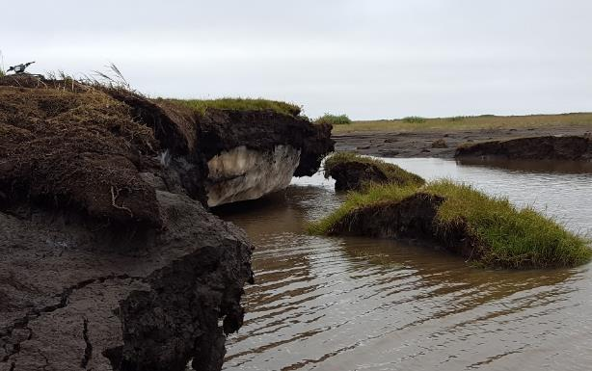
Challenges
Permafrost Degradation
Notes:
Pt. Lay Drained Lake

Slide 27
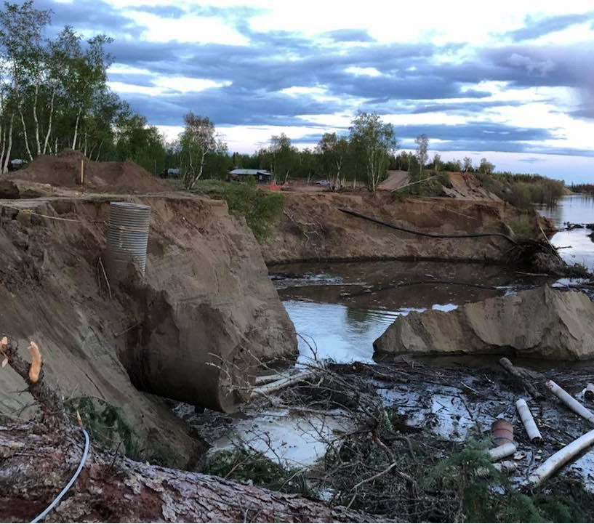
Challenges
River Erosion
Notes:
Koyukuk River

Slide 28
Tips
Call us with questions
Let us know your turnaround time
Be specific regarding locations, details, etc.
If you’re referring to a spec let us know exactly where it is
Check CAD drawings for clarity (abbreviations, faint lines, etc.)
If you know there is an issue with the design, discuss it
Review and check data for organization and clarity (interim approvals, as-built or record drawings, etc.)
Review general permit requirements and water quality standards
Remote Temporary Camp Permit (<25 people; streamlines approval): http://dec.alaska.gov/eh/fss/food/temporary-camps/
Notes:
Electronic plans—Not usually accepted.
Remote Camp Permit applies to camps that have no year-round access to a major road system and are > 25 miles from a community or highway.

Slide 29
For More Information
Contact your local DEC staff in Fairbanks:
  Drinking Water
  Lee Johnson, P.E.: 451-2179 or lee.johnson@alaska.gov
  Johnny Mendez, P.E.: 451-5193 or johnny.mendez@alaska.gov
  Nellie Ballou.: 451-2165 or nellie.ballou@alaska.gov
  Shawna Laderach, P.E.: 451-5032 or shawna.laderach@alaska.gov
  Wastewater
  Marie Klingman, EPS->Domestic & Industrial Discharge Permits 451-2101 or marie.klingman@alaska.gov
  Tonya Bear, P.E.->Engineering Plan Review 451-2177 or tonya.bear@alaska.gov
Visit the DEC Drinking Water & WW Program Websites at:
    http://dec.alaska.gov/eh/dw.aspx
    https://dec.alaska.gov/water/wastewater/engineering/

Slide 30
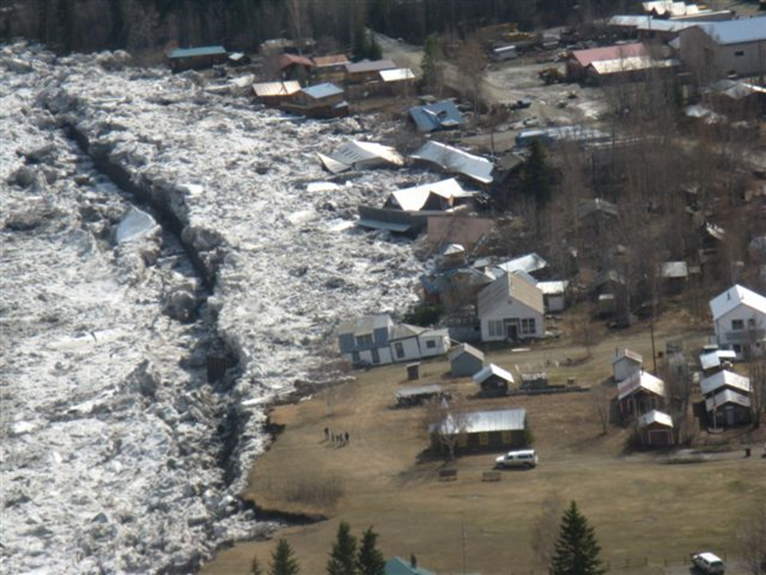
Questions/Open Discussion

